Slide 1




Slide 2
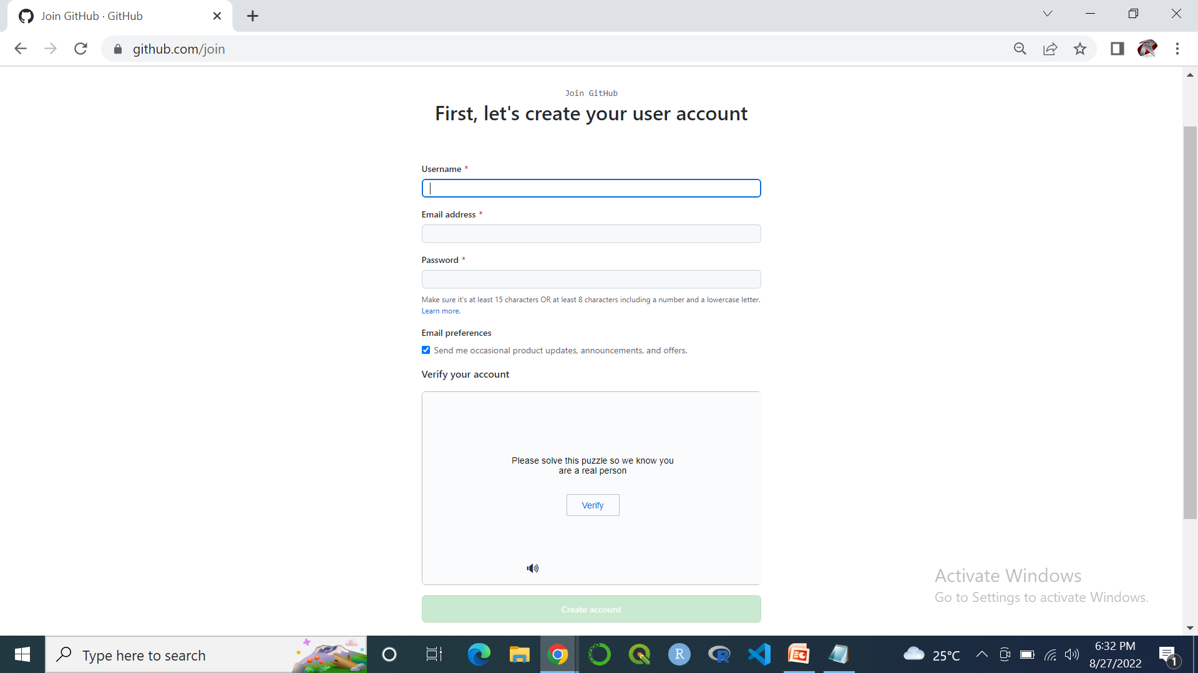
How to Create an Account on GitHub

Slide 3
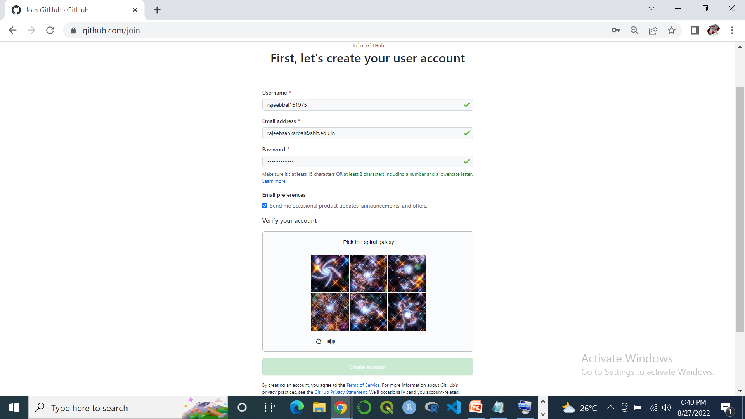
Create an Account on GitHub Conti………

Slide 4
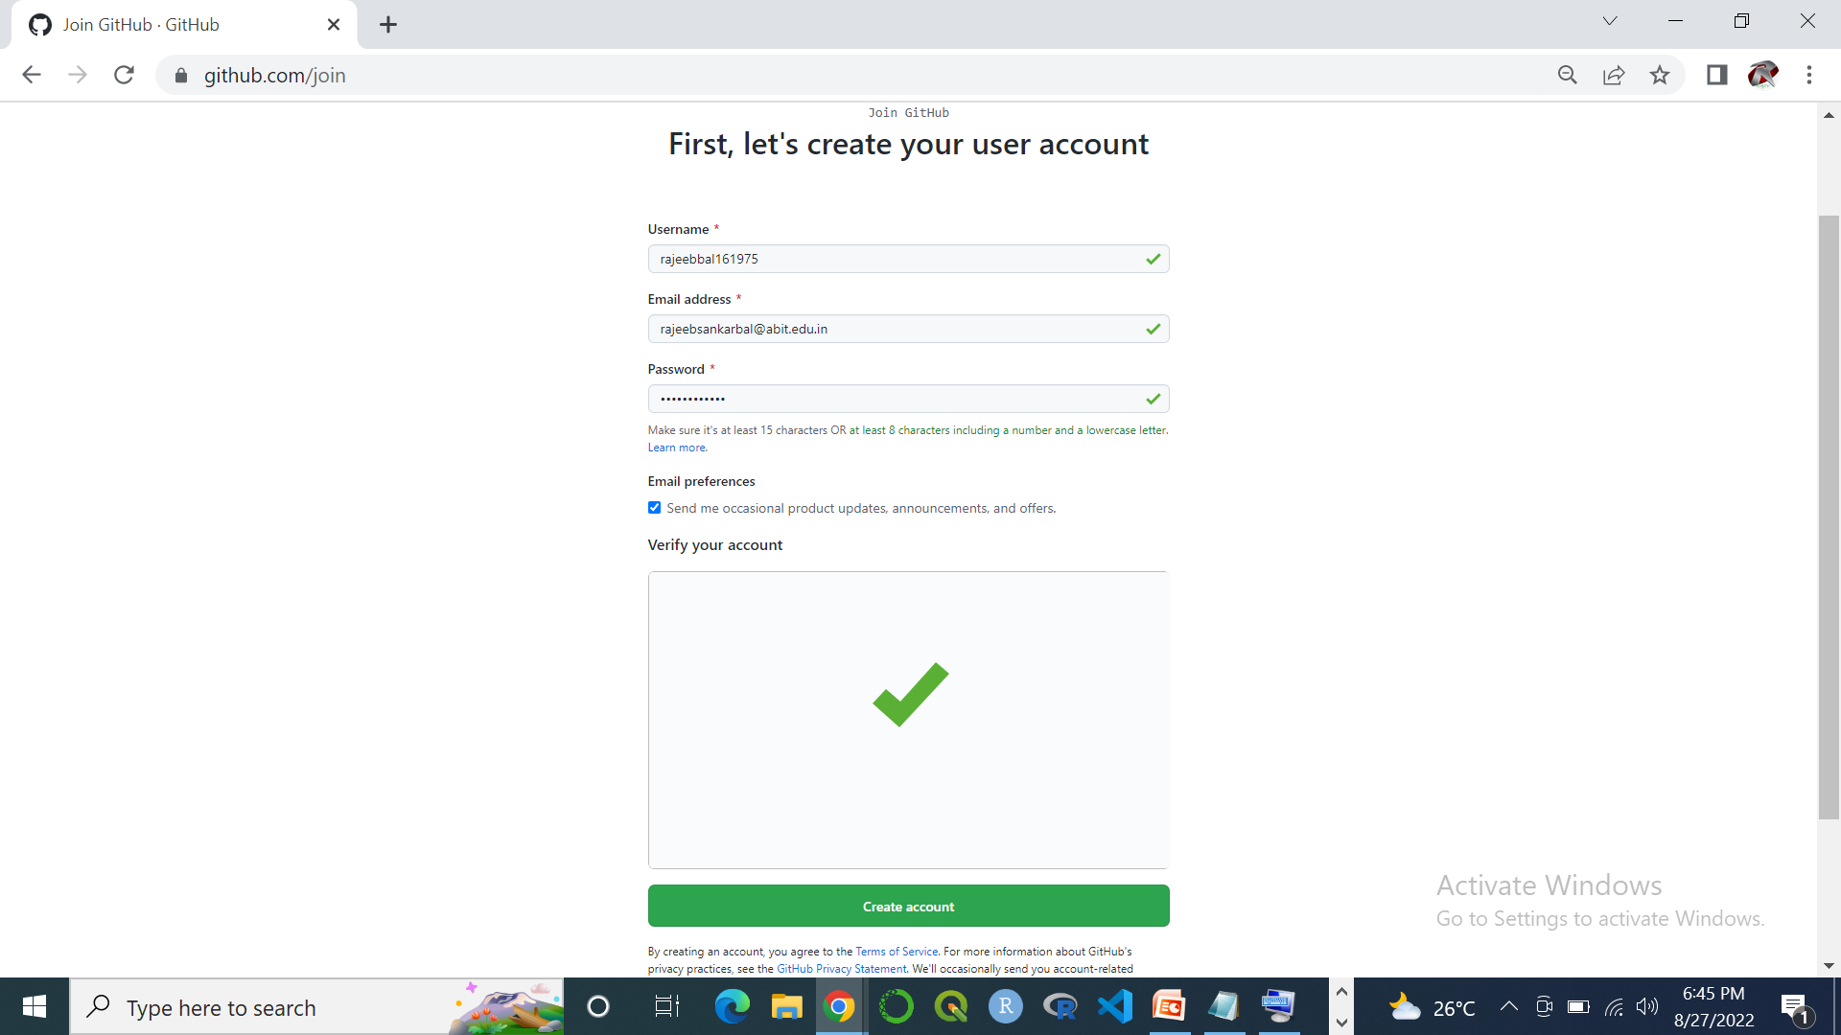
Create an Account on GitHub Conti………

Slide 5
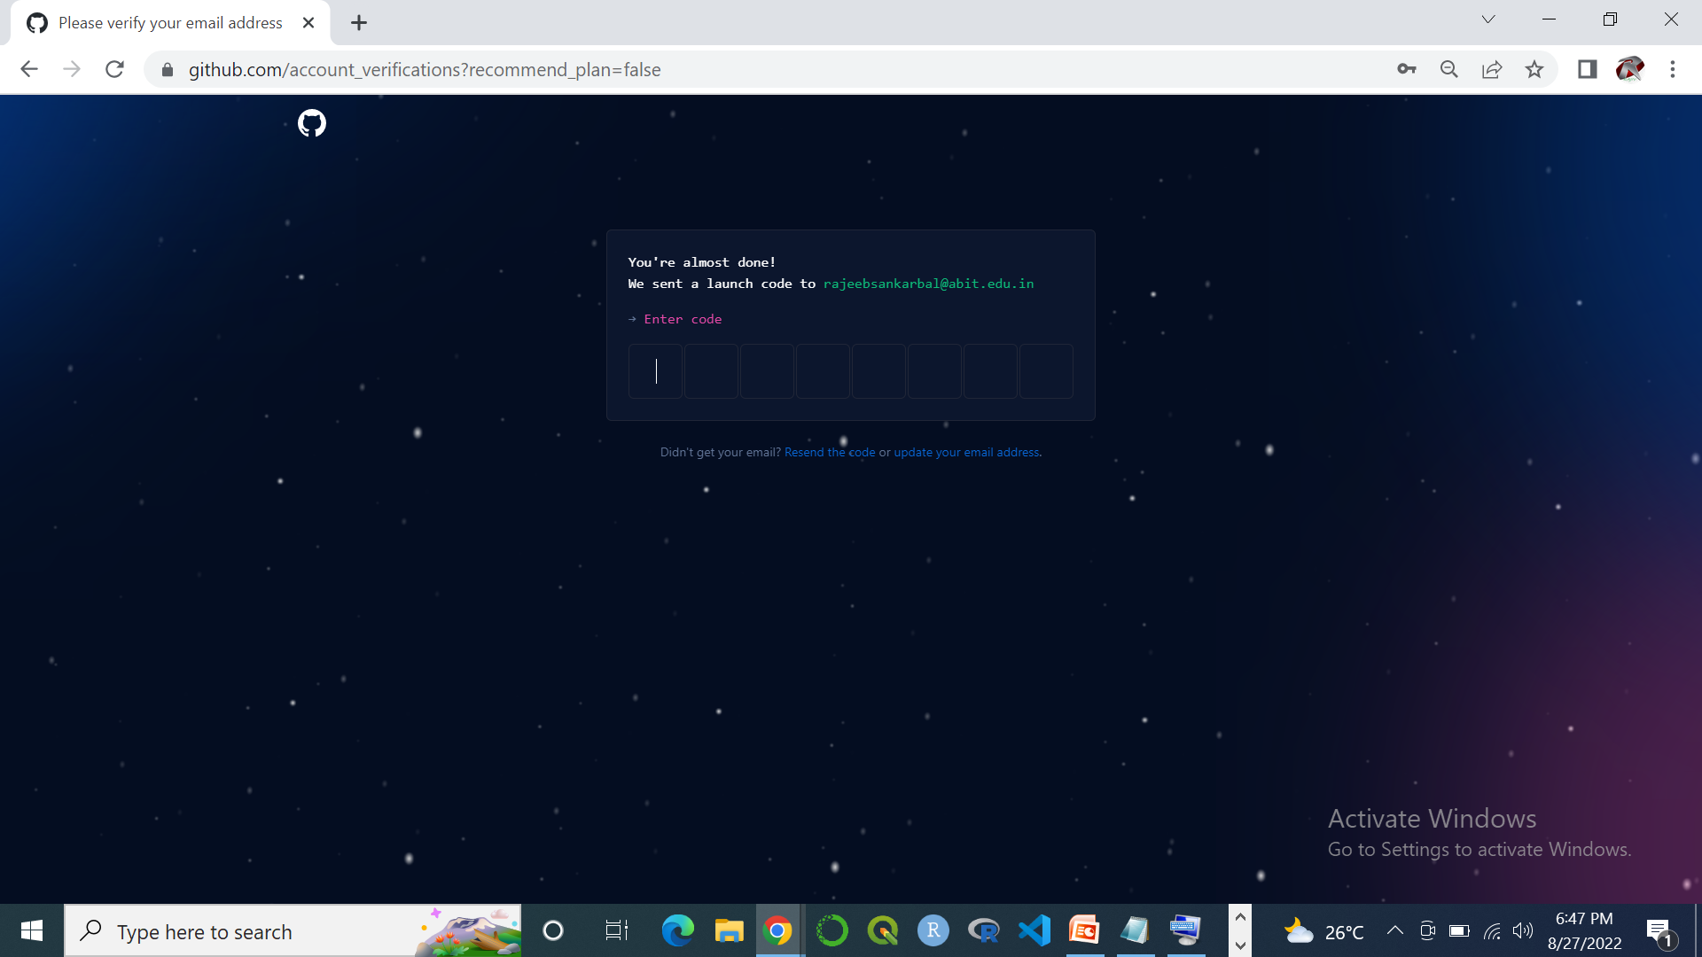
Create an Account on GitHub Conti………

Slide 6
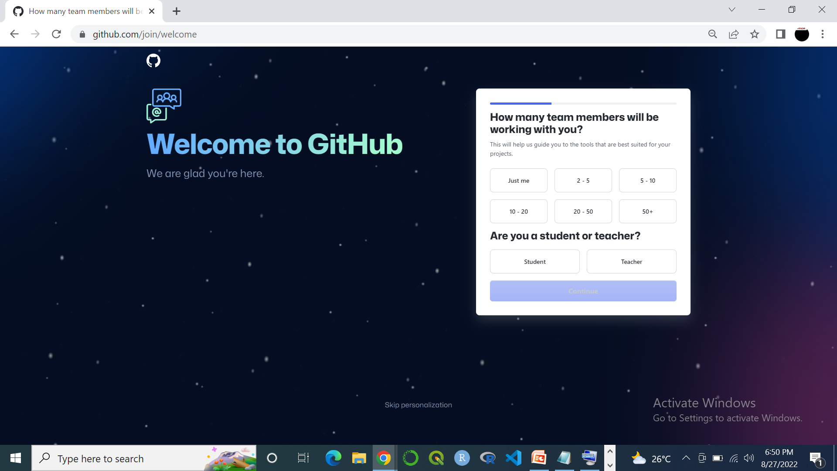
Create an Account on GitHub Conti………

Slide 7
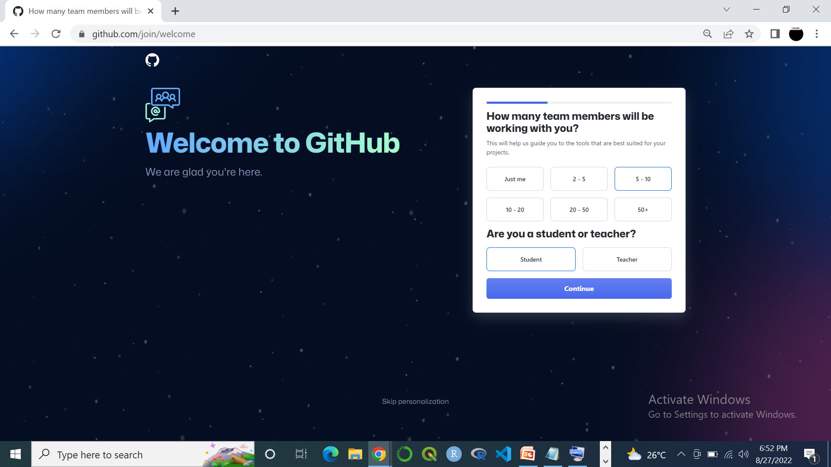
Create an Account on GitHub Conti………

Slide 8
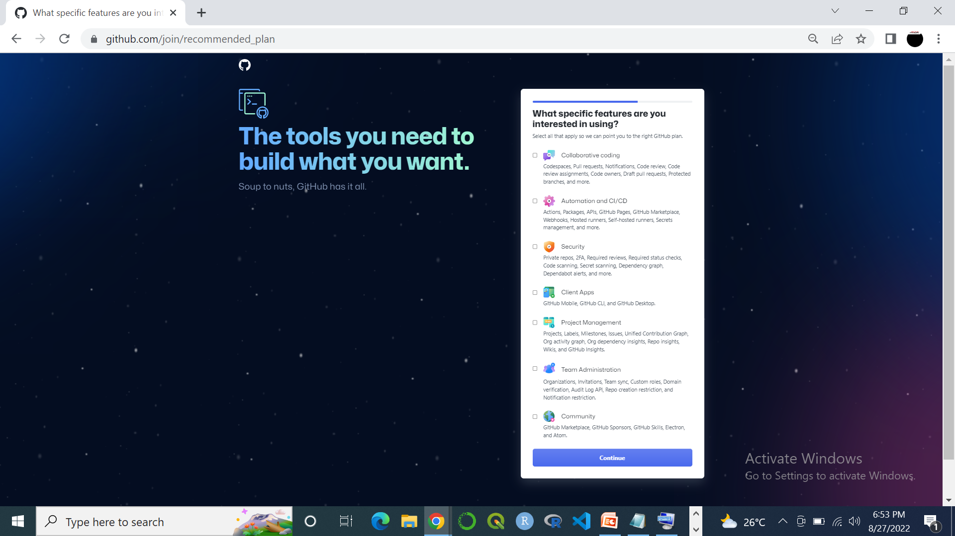
Create an Account on GitHub Conti………

Slide 9
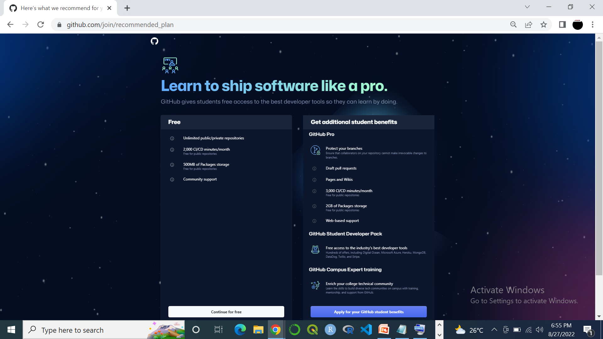
Create an Account on GitHub Conti………

Slide 10
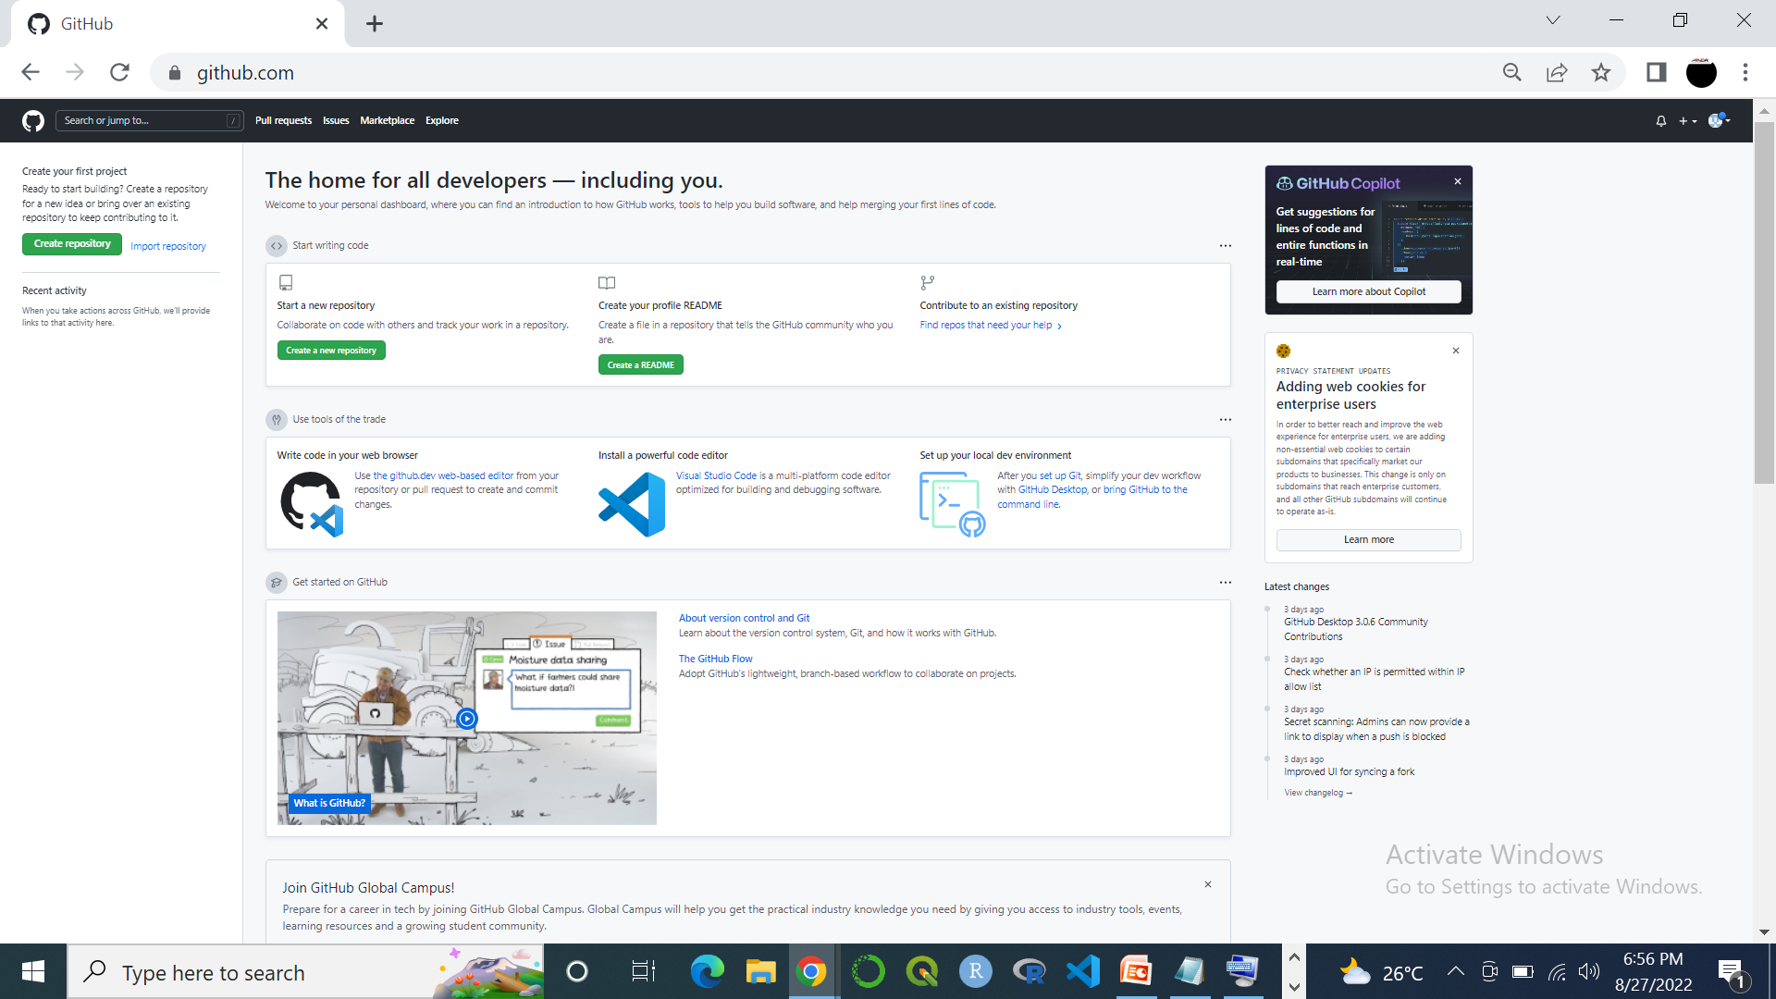
Create an Account on GitHub Conti………

Slide 11
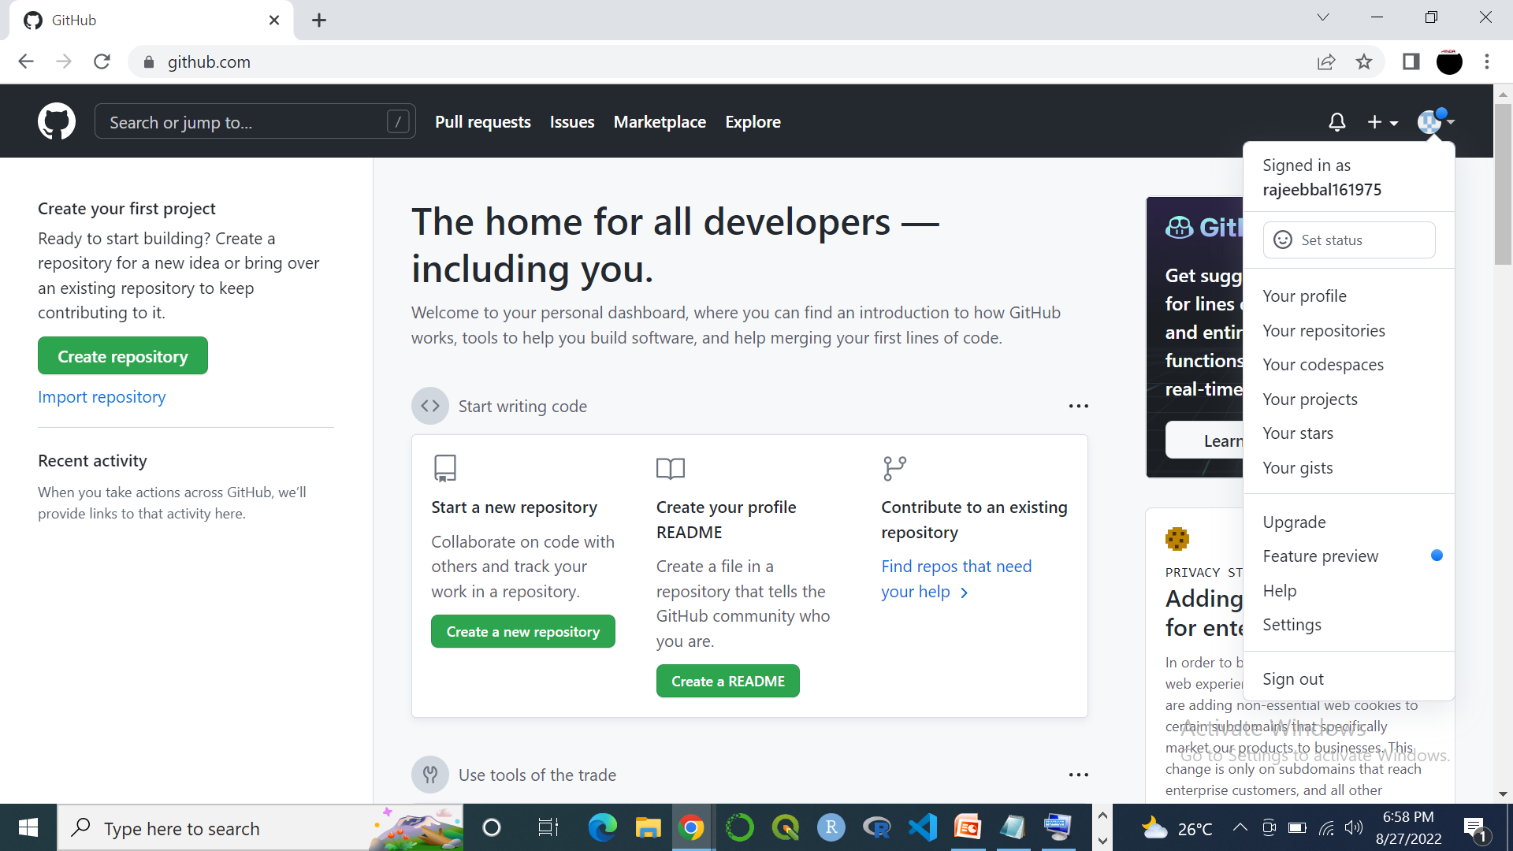
Create an Account on GitHub Conti………

Slide 12



Slide 13


Slide 14
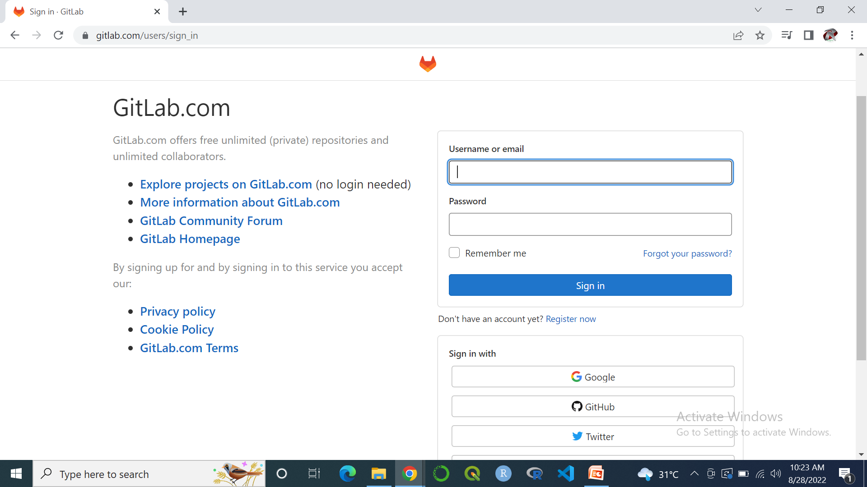


Open link in Web Browser: https://gitlab.com/users/sign_in
How to Create an Account on GitLab
Click for Create an Account on GitLab

Slide 15
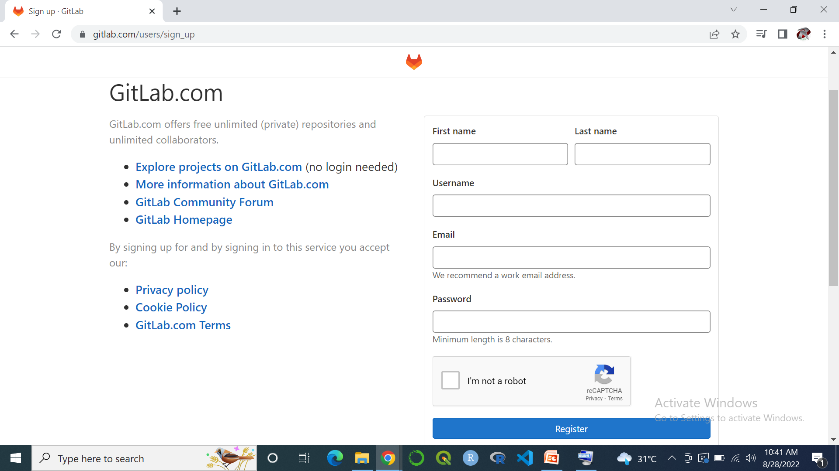
How to Create an Account on GitLab Conti…

Slide 16
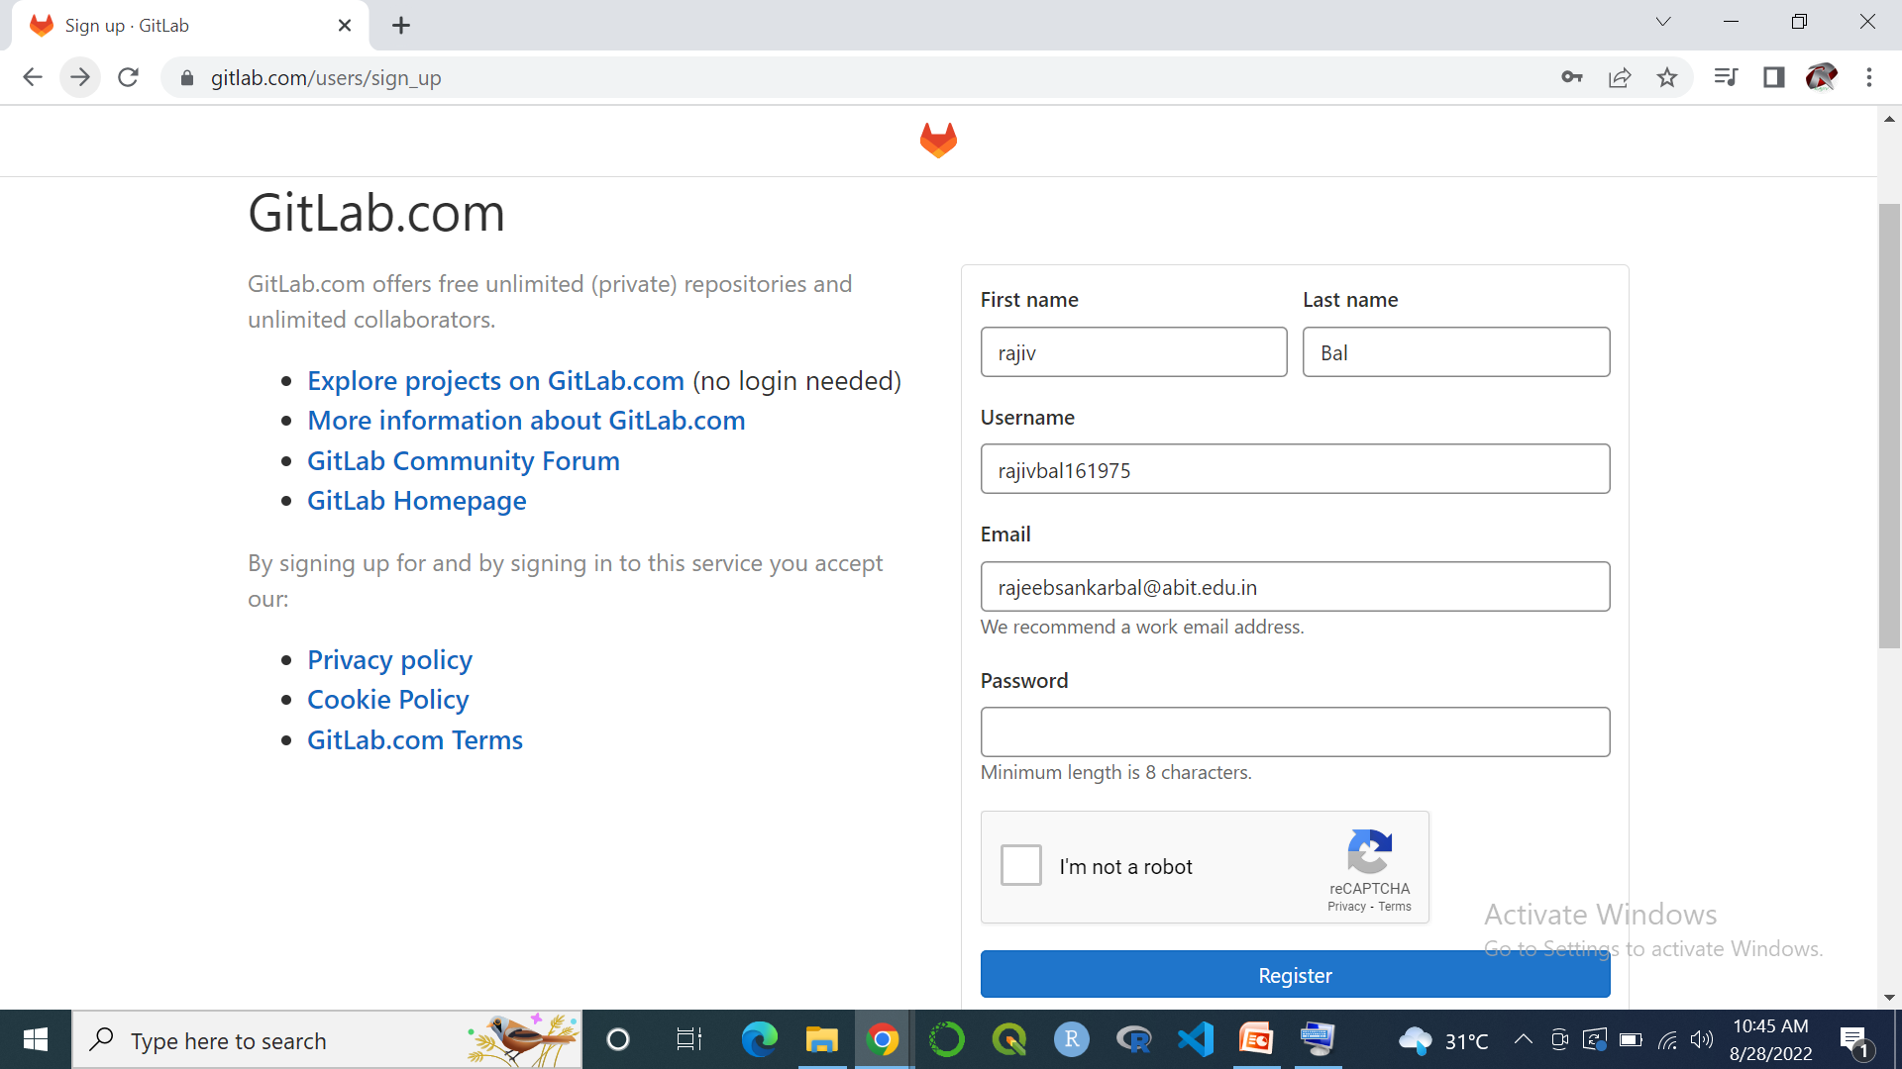
How to Create an Account on GitLab Conti…

Slide 17


Slide 18
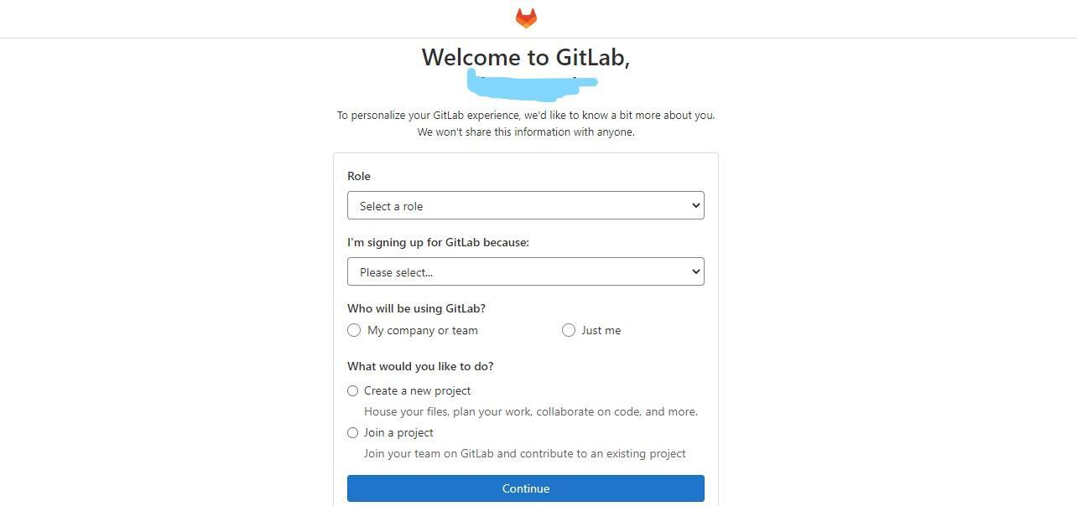
Creating a GitLab Account
Step 1: Go to https://gitlab.com/users/sign_up. If you have an existing Google or GitHub account, you can as well use them to sign up.
Step 2: When you’re on https://gitlab.com/users/sign_up, key in the necessary details and click; ‘register’ to complete the sign-up process.

Slide 19
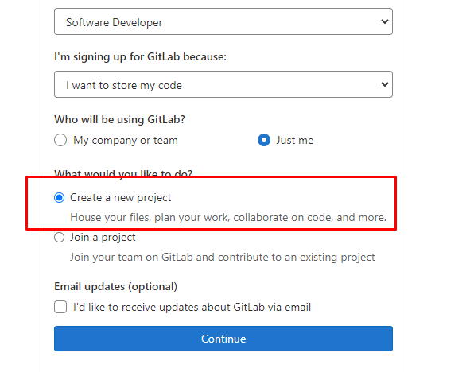
Step 3: Confirm your email address and then proceed to personalize your profile as shown below:
Step 4: Select ‘Create a new project’ under ‘what would you like to do as shown below and then click, ‘Continue’:

Slide 20
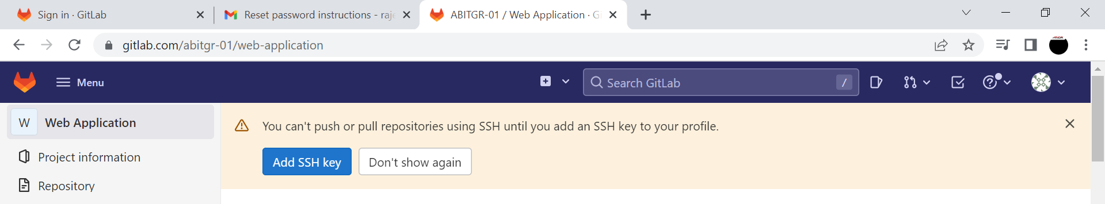

How to create / generate SSH key for GitLab
Click for Generate SSH Key

Slide 21
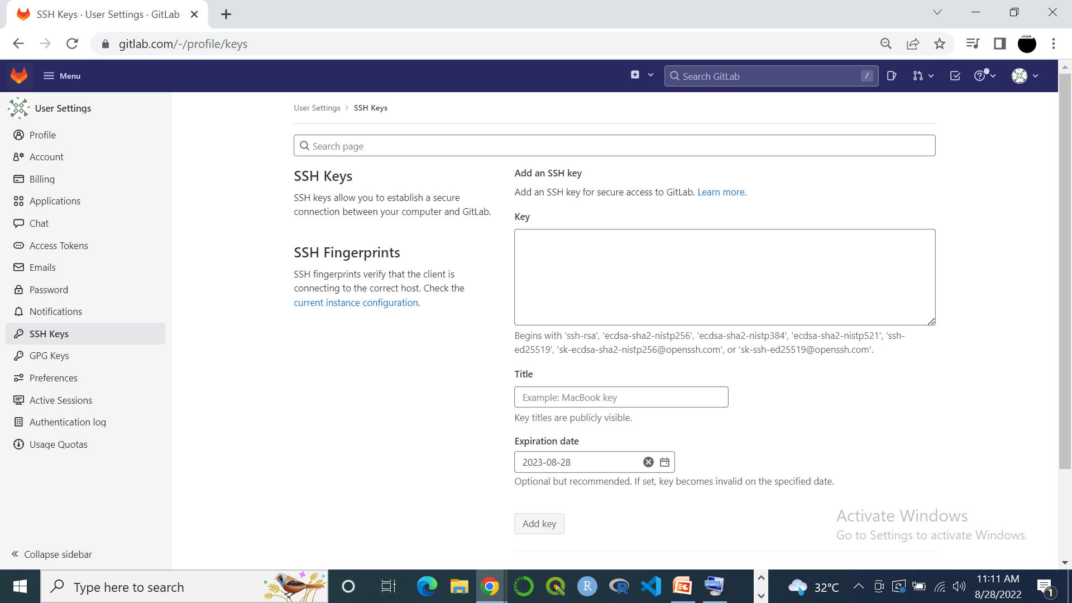
SSH Key Page Conti…

Slide 22
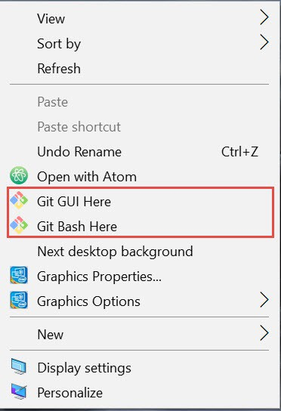
Click for Git GUI Window

Slide 23
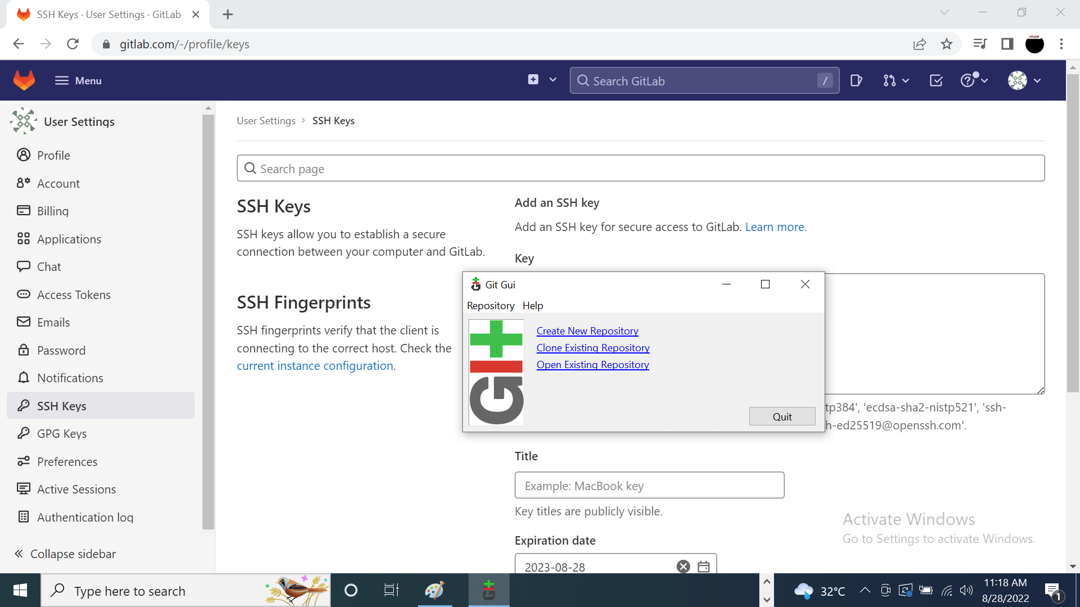
Git GUI Window

Slide 24
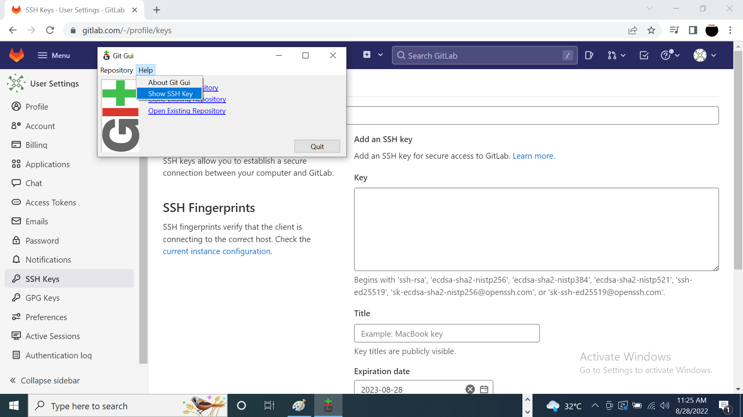
Click for Generate SSH Key

Slide 25
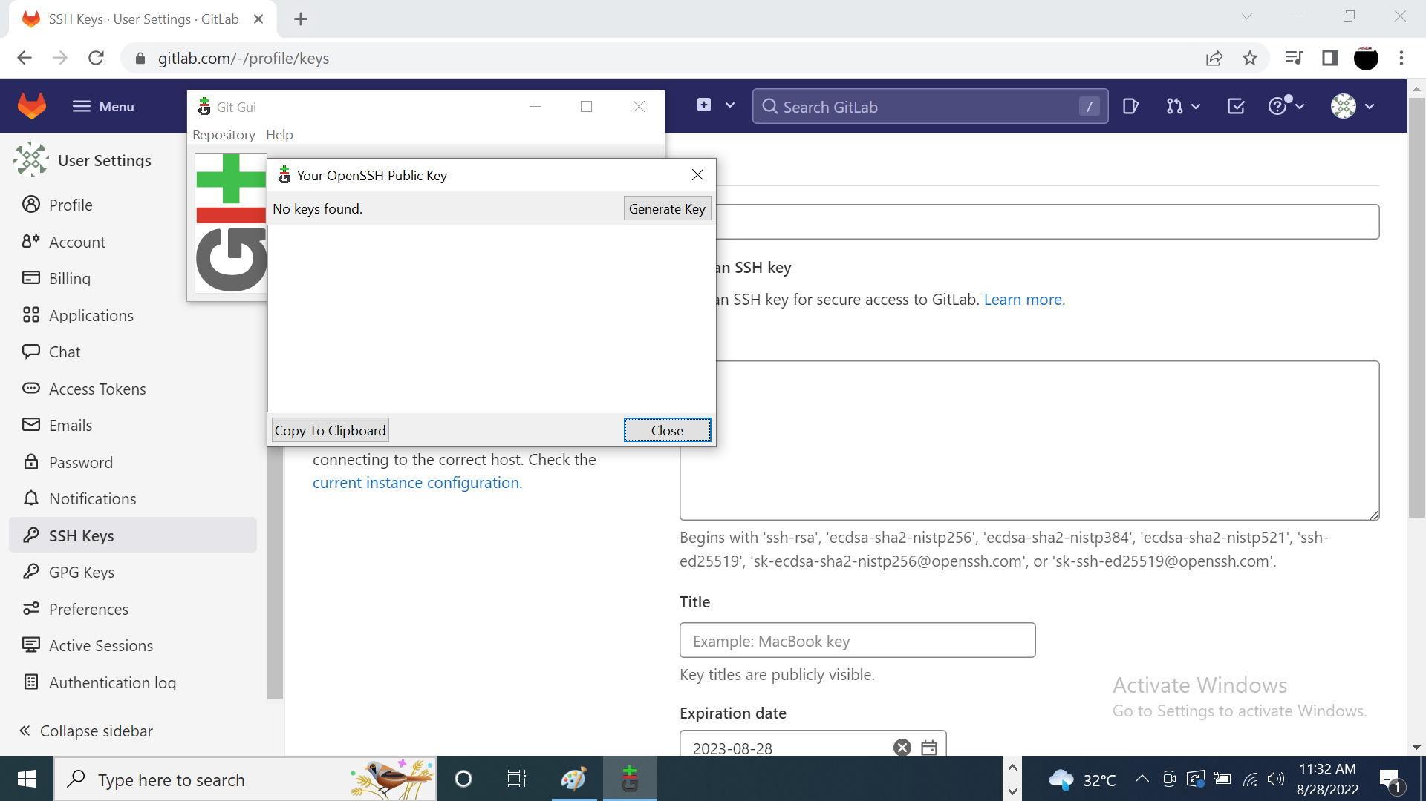
Click for Generate Key

Slide 26

Click Ok Two Times

Slide 27
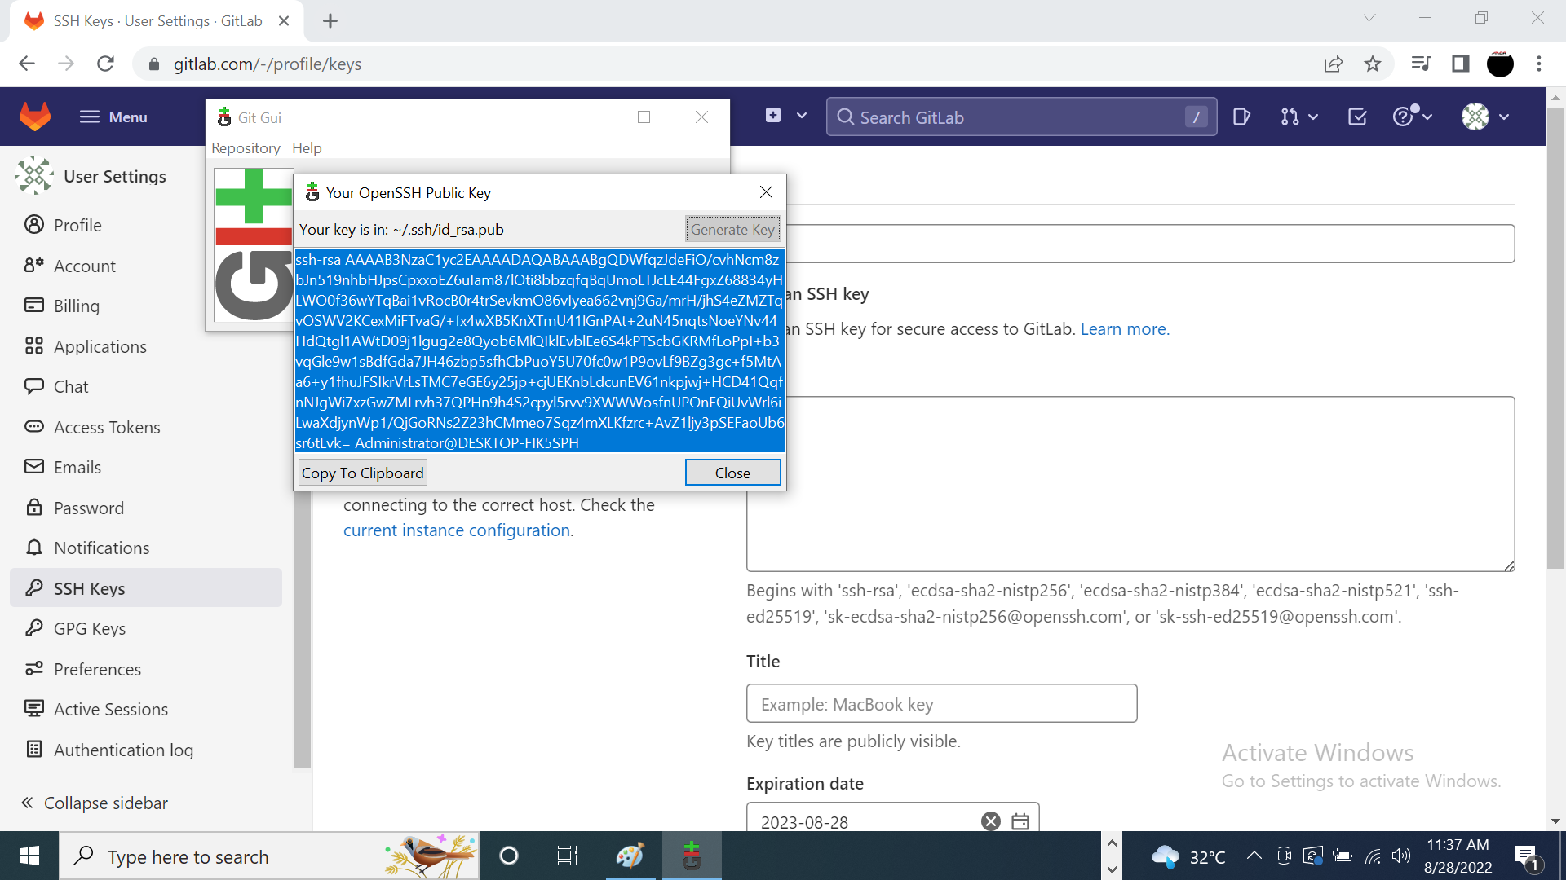
Click Copy To Clipboard

Slide 28
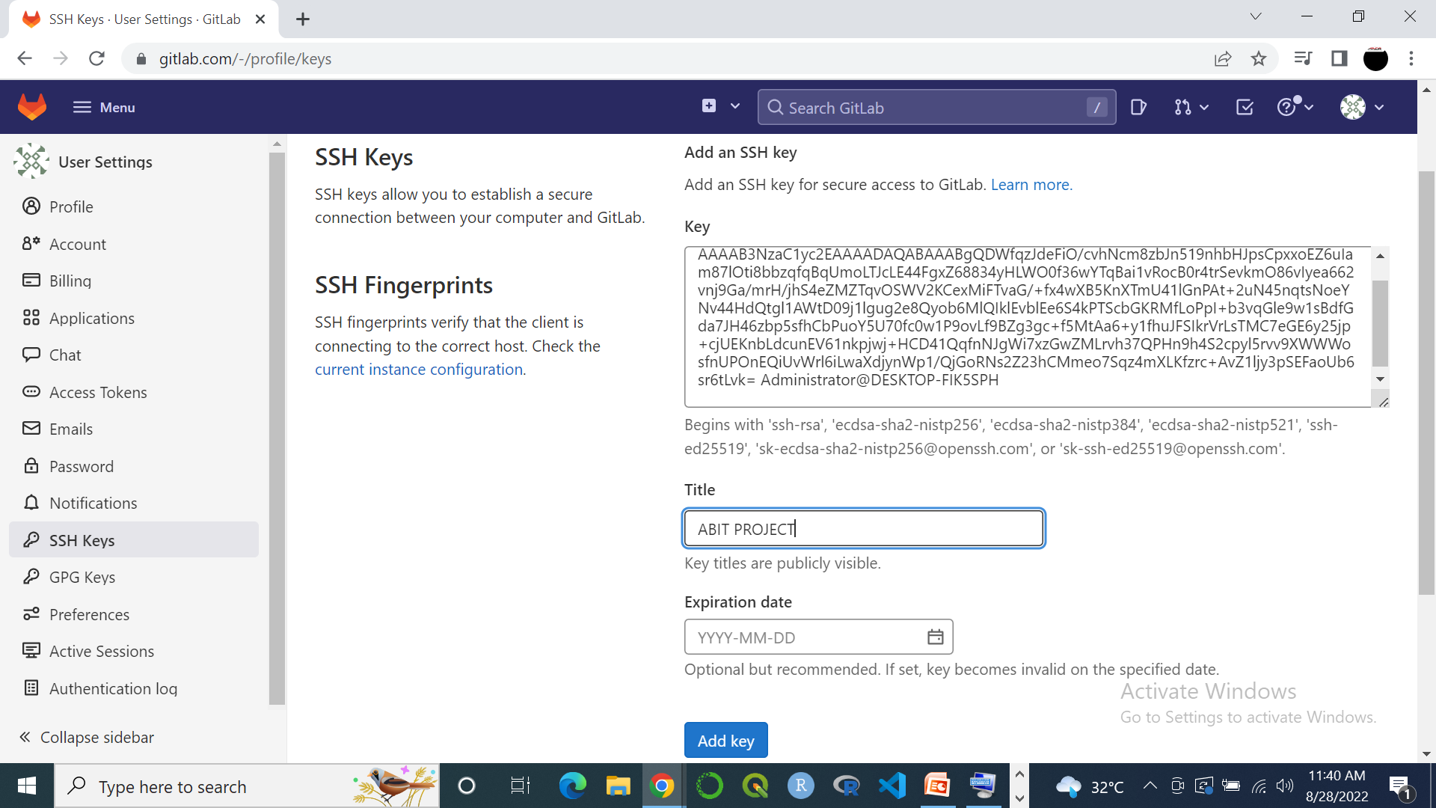

SSH Key
No Expiration Date
Click
Give Title Name
Click on Add Key

Slide 29
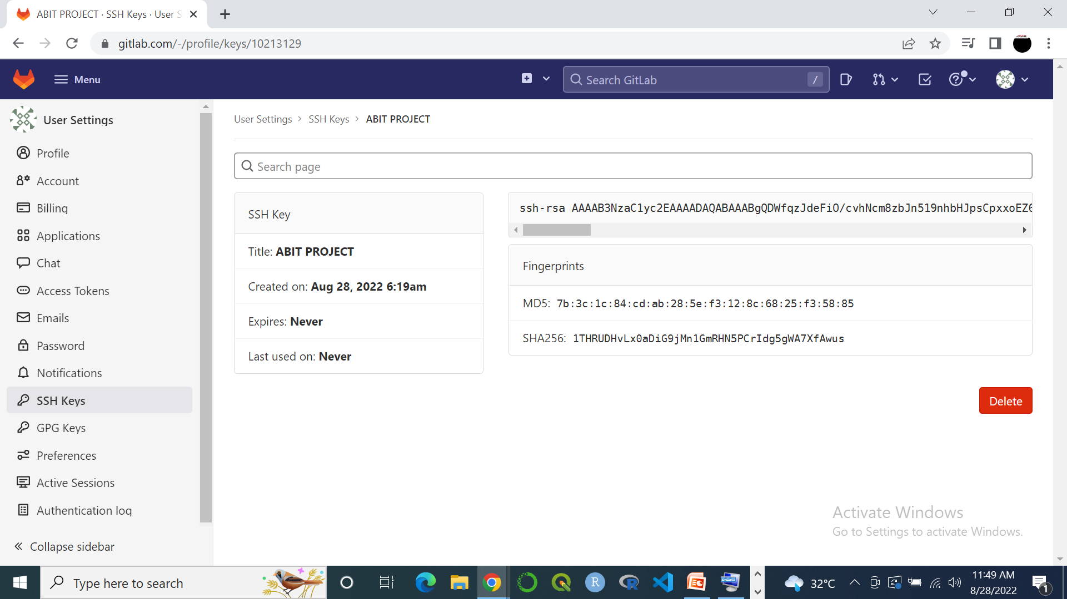
Active of SSH Key

Slide 30


Slide 31
What is Git?
Click For git :
https://git-scm.com/downloads

Slide 32
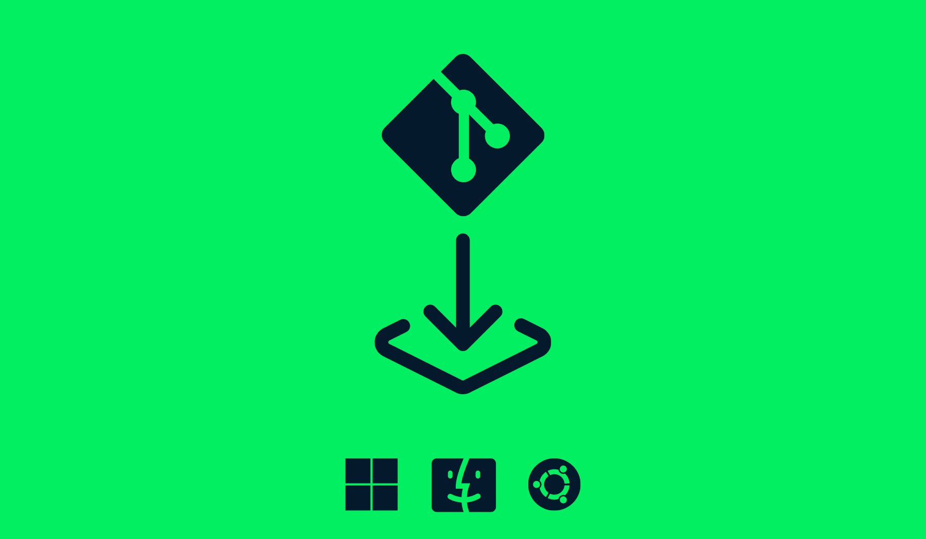

Git Install
Install Git on Ubuntu
Install Git on Windows
Install Git on Mac OS X

Slide 33
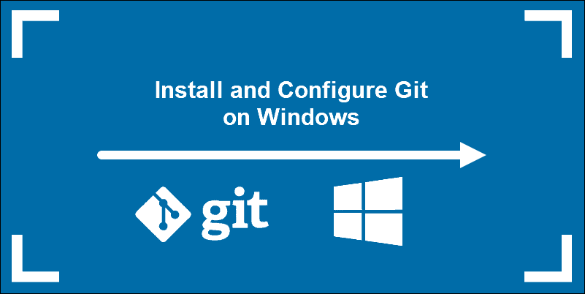
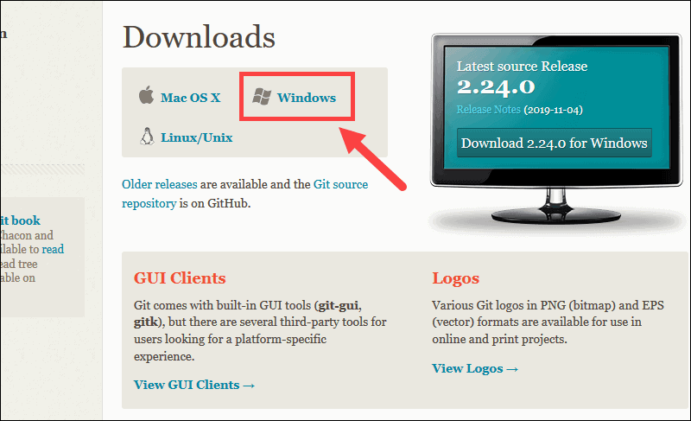
How to Install and Use Git on Windows
Steps For Installing Git for Windows
Download Git for Windows
1. Browse to the official Git website: https://git-scm.com/downloads 2. Click the download link for Windows and allow the download to complete.

Slide 34
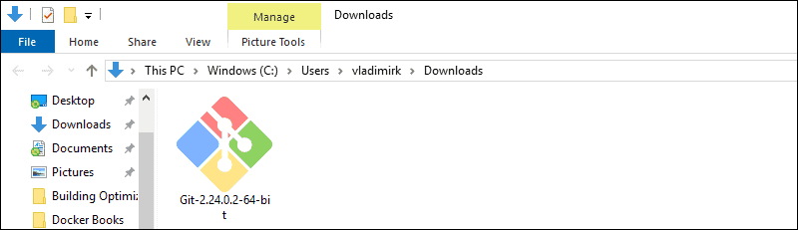
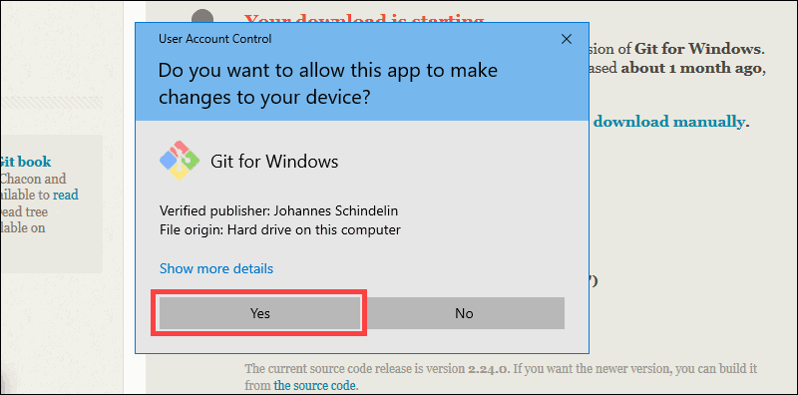
Extract and Launch Git Installer
3. Browse to the download location (or use the download shortcut in your browser). Double-click the file to extract and launch the installer.
4. Allow the app to make changes to your device by clicking Yes on the User Account Control dialog that opens.

Slide 35
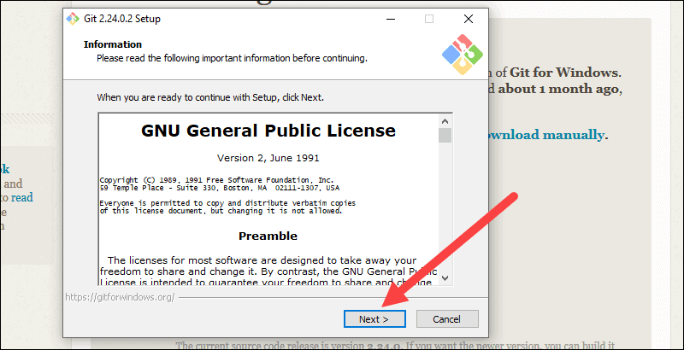
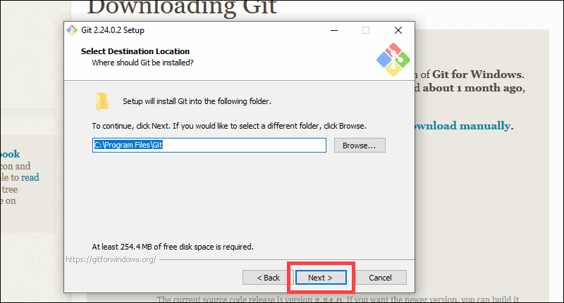
5. Review the GNU General Public License, and when you’re ready to install, click Next.
6. The installer will ask you for an installation location. Leave the default, unless you have reason to change it, and click Next.

Slide 36
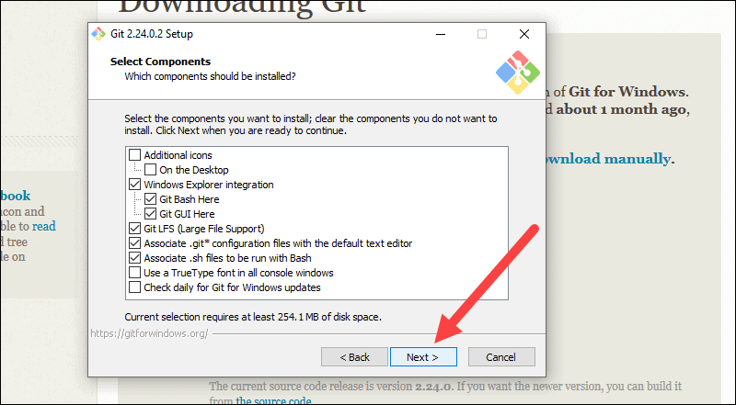
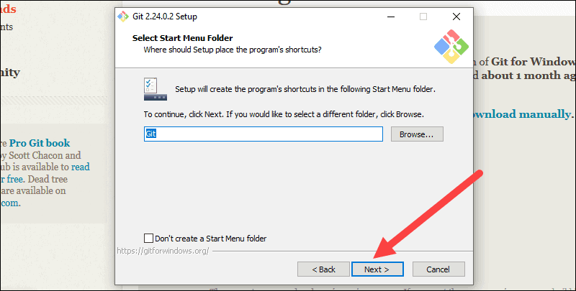
7. A component selection screen will appear. Leave the defaults unless you have a specific need to change them and click Next.
8. The installer will offer to create a start menu folder. Simply click Next.

Slide 37
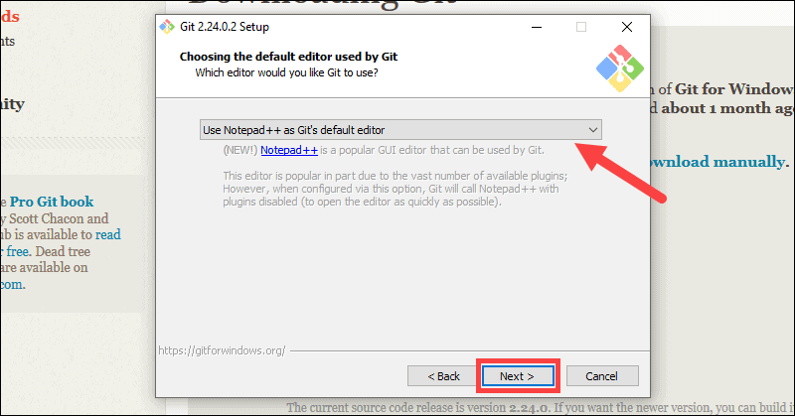
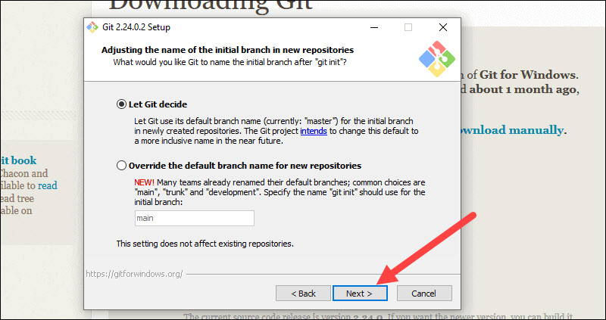
9. Select a text editor you’d like to use with Git. Use the drop-down menu to select Notepad++ (or whichever text editor you prefer) and click Next.
10. The next step allows you to choose a different name for your initial branch. The default is 'master.' Unless you're working in a team that requires a different name, leave the default option and click Next.

Slide 38
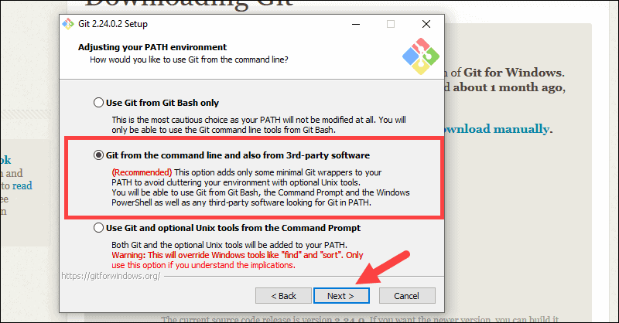
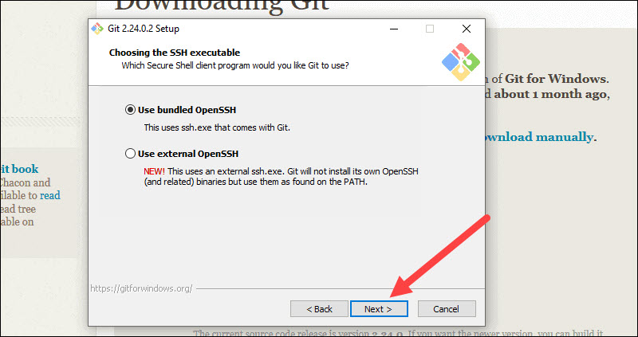
11. This installation step allows you to change the PATH environment. The PATH is the default set of directories included when you run a command from the command line. Leave this on the middle (recommended) selection and click Next.
Server Certificates, Line Endings and Terminal Emulators
12. The installer now asks which SSH client you want Git to use. Git already comes with its own SSH client, so if you don't need a specific one, leave the default option and click Next.

Slide 39
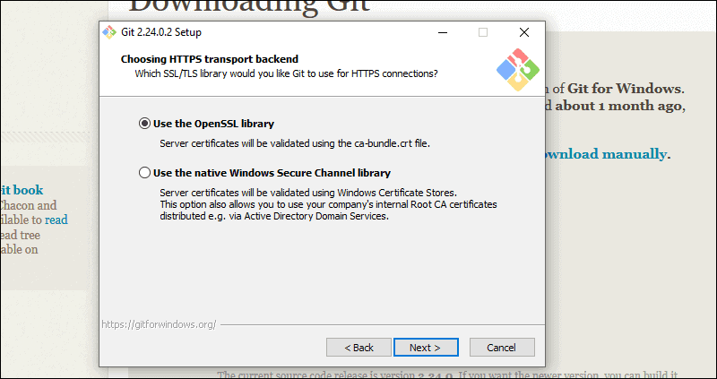
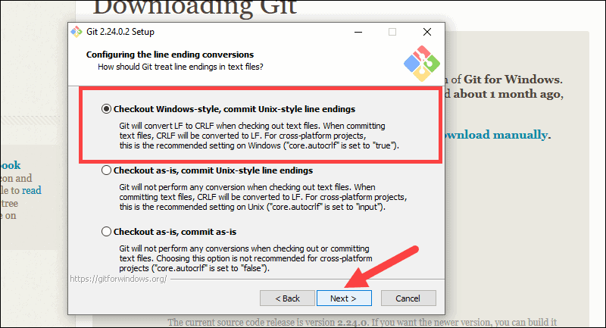
13. The next option relates to server certificates. Most users should use the default. If you’re working in an Active Directory environment, you may need to switch to Windows Store certificates. Click Next.
14. The next selection converts line endings. It is recommended that you leave the default selection. This relates to the way data is formatted and changing this option may cause problems. Click Next.

Slide 40
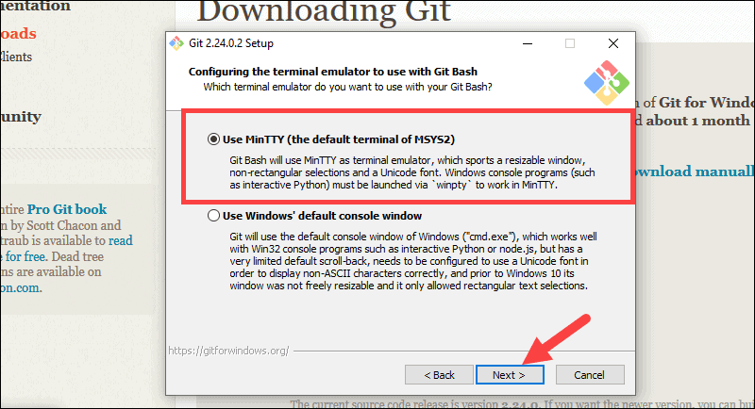
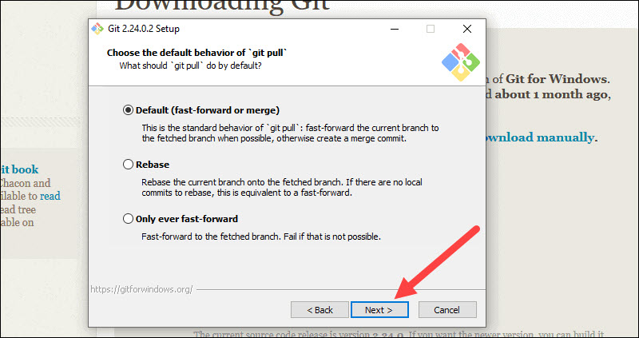
15. Choose the terminal emulator you want to use. The default MinTTY is recommended, for its features. Click Next.
16. The installer now asks what the git pull command should do. The default option is recommended unless you specifically need to change its behavior. Click Next to continue with the installation.

Slide 41
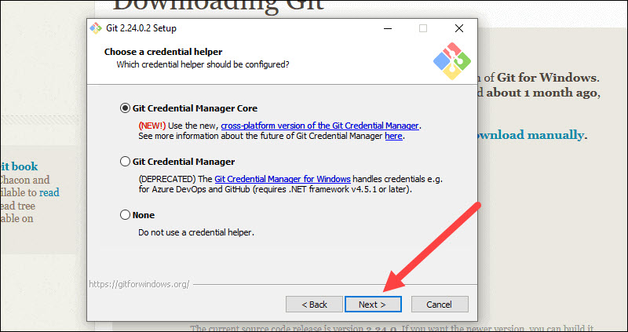
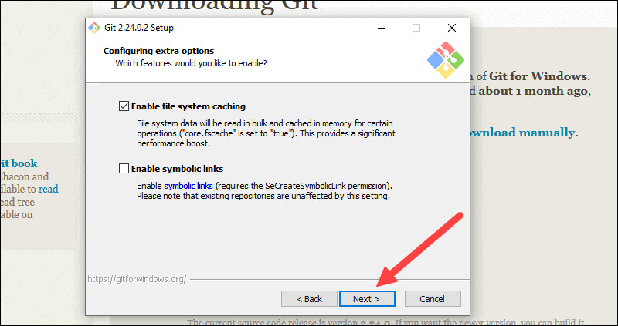
17. Next you should choose which credential helper to use. Git uses credential helpers to fetch or save credentials. Leave the default option as it is the most stable one, and click Next.
Additional Customization Options
18. The default options are recommended, however this step allows you to decide which extra option you would like to enable. If you use symbolic links, which are like shortcuts for the command line, tick the box. Click Next.

Slide 42
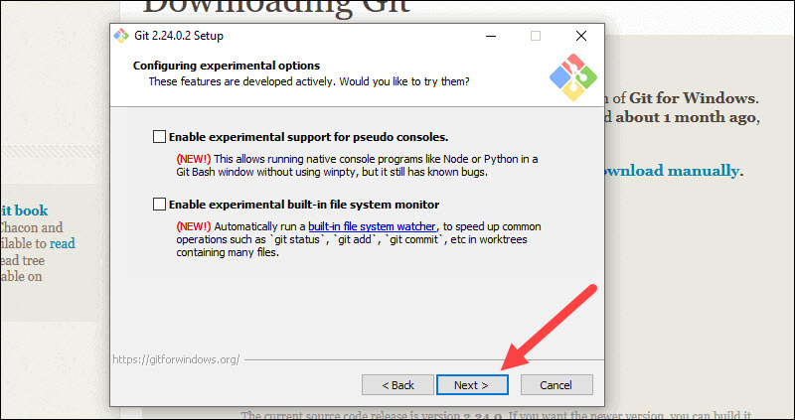
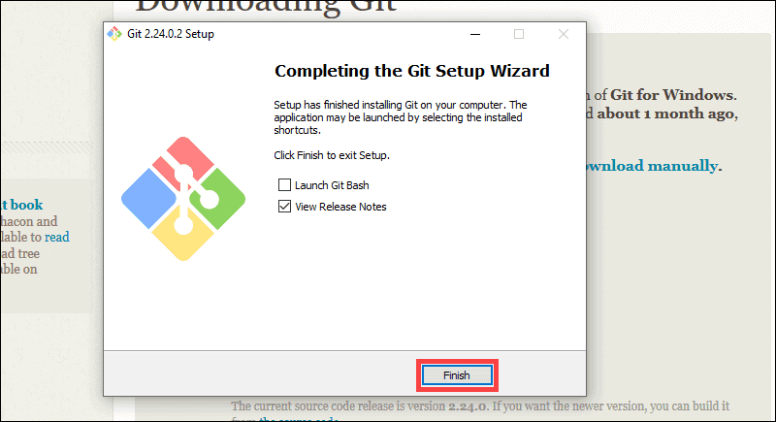
19. Depending on the version of Git you’re installing, it may offer to install experimental features. At the time this article was written, the options to include support for pseudo controls and a built-in file system monitor were offered. Unless you are feeling adventurous, leave them unchecked and click Install.
Complete Git Installation Process
20. Once the installation is complete, tick the boxes to view the Release Notes or Launch Git Bash, then click Finish.

Slide 43
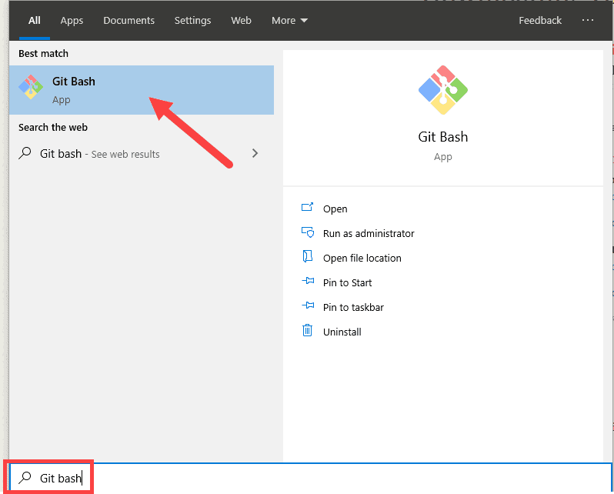
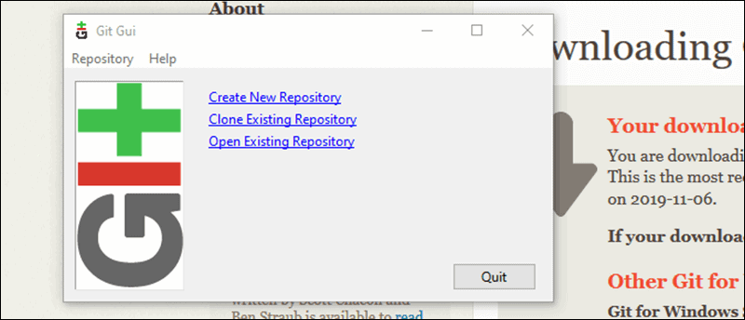
How to Launch Git in Windows
Git has two modes of use – a bash scripting shell (or command line) and a graphical user interface (GUI).
Launch Git Bash Shell
To launch Git Bash open the Windows Start menu, type git bash and press Enter (or click the application icon).
Launch Git GUI
To launch Git GUI open the Windows Start menu, type git gui and press Enter (or click the application icon).

Slide 44
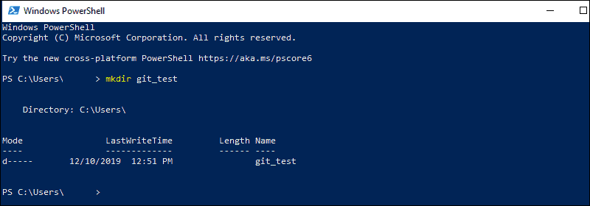
Create a Test Directory
Open a Windows PowerShell interface by pressing Windows Key + x, and then i once the menu appears.
Create a new test directory (folder) by entering the following:
mkdir git_test
An example of the PowerShell output.
Change your location to the newly created directory:
cd git_test

Slide 45
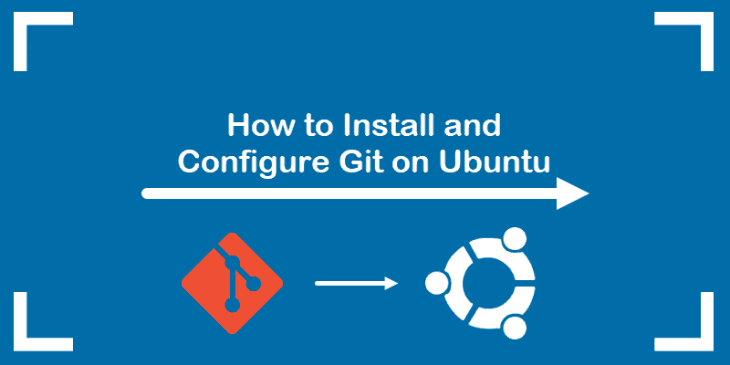
Steps For installing and configuring Git on Ubuntu 18.04 or Ubuntu 20.04.
Install Git with Apt on Ubuntu
Using the apt package management tool is the easiest way to install Git. However, the version in the default repositories may not be the latest release from the developer. If you want to install the latest release, skip down to install from source.
1. To update the packages, launch a terminal window, and enter:
sudo apt-get update
This helps to ensure you’re working with the latest software versions.
2. To install from the default repositories, enter the following:
sudo apt-get install git
Allow the process to complete.

Slide 46
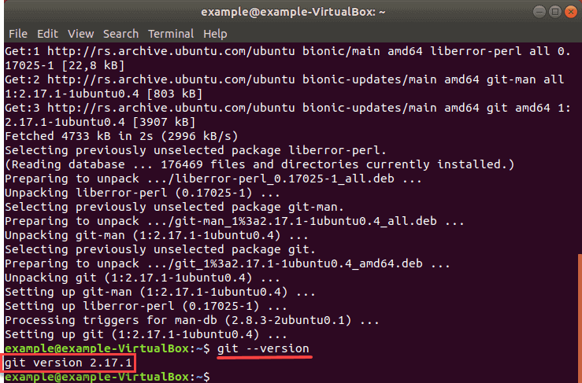
3. Verify the installation and version by entering:
git --version
The output should appear as seen below:

Slide 47
Install Git From Source Code
To use the latest version of Git on Ubuntu, download and install from the original source code.
1. Start by installing the following packages:
sudo apt install make libssl-dev libghc-zlib-dev libcurl4-gnutls-dev libexpat1-dev gettext unzip
Allow the process to complete.
2. Open a browser window and navigate to the following address:
https://github.com/git/git
3. You can select the version of Git you download by changing the branch to a specific version. Select the Master Branch.
Also, at the top, you see a link labeled releases to browse the different release versions. It is recommended that you avoid versions labeled with “rc.” This stands for release candidate, and may not be completely stable.
To see Page next

Slide 48

back

Slide 49

4. Click the green Clone or download button on the right-hand side. Copy the URL by clicking on the file icon.

Slide 50

5. Switch back to your command prompt and enter the following:
cd /tmp
6. You are now working in the temp directory. Type in the following command:
sudo wget https://github.com/git/git/archive/master.zip -O git.zip
This downloads the Git file, and renames it git.zip.

Slide 51

NOTE: If you found a package under the releases page, you can substitute the link to that version. For example:
sudo wget https://github.com/git/git/archive/v2.20.1.zip -O git.zip
7. Next, extract the zip files by entering the command:
unzip git.zip
8. Allow the process to finish. Then, move to the new directory:
cd git-*
9. Then, compile the package with the following command:
make prefix=/usr/local/
10. And once the process is finished, install the software with:
sudo make prefix=/usr/local install
11. Verify Git installation by entering:
git --version
The output should appear as:
Git version 2.18.0

Slide 52

Configuring Git
Git contains a basic configuration file that holds your information. Setting your username and email address is essential.
1. In a terminal window, enter the following and replace your_name with your name, and email@address.com with your email address.:
git config --global user.name "your_name"
git config --global user.email "email@address.com"
2. Verify configuration changes with the command:
git config --list
The system should display the name and email address you just entered.

Slide 53
Steps For Install Git on macOS X
macOS Xcode comes with built-in Git and GitHub features; and if you are not an Xcode user, you can install Git with Homebrew, MacPort, or a binary installer.
Install Git with Homebrew
Homebrew is a package manager for macOS. You can install, modify, and uninstall applications using a simple command in the terminal.
First, you need to install Homebrew, then type the command into the terminal.
brew install git
To Install git-gui and gitk for a user-friendly experience and browsing interactive commit history, type in the command below.
brew install git-gui
Install Git with MacPort
MacPorts, a software manager for macOS systems, is similar to Homebrew. If you have MacPorts installed, then:
sudo port install git

Slide 54

Install Git with Mac Installer
You can also install Git using the installer by Tim Harper. Download and install the latest setup from SourceForge.net.
By following the installation instructions and keeping everything in its default setting, you can install the Git package within a few minutes.

Slide 55
How To Upload Files To Github

Slide 56
How To Upload Files To GitLab
1. git init
2. git config --global user.email "rajeebsankar.bal@abit.edu.in"
3. git config --global user.name "Rajeeb Bal"
4. git add .
5.
$ git remote add origin https://gitlab.com/abit_application/test.git
error: remote origin already exists.
6.
$ git remote rm origin
$ git remote add origin https://gitlab.com/abit_application/test.git
7.
$ git branch -M main
8.
$ git push -uf origin main
Enumerating objects: 3, done.
Counting objects: 100% (3/3), done.
Writing objects: 100% (3/3), 220 bytes | 220.00 KiB/s, done.
Total 3 (delta 0), reused 3 (delta 0), pack-reused 0
remote: GitLab: You are not allowed to force push code to a protected branch on this project.
To https://gitlab.com/abit_application/test.git
! [remote rejected] main -> main (pre-receive hook declined)
error: failed to push some refs to 'https://gitlab.com/abit_application/test.git
8.
Solution:
Go to Settings > Repository > Protected Branches and enable "Allowed to force push".

Slide 57
How To Upload Eclipse To GitLab

Slide 58

GIT WITH GITLAB USING GUI BASED
Click for Download Git GUI

Slide 59

GIT WITH GITLAB USING GUI BASED (Conti.)

Slide 60

GIT WITH GITLAB USING GUI BASED (Conti.)
Click for Download Git GUI

Slide 61

GIT WITH GITLAB USING GUI BASED (Conti.)
Click to Skip

Slide 62

GIT WITH GITLAB USING GUI BASED (Conti.)
Click to Next

Slide 63

GIT WITH GITLAB USING GUI BASED (Conti.)
Click for Generate SSH Key

Slide 64

GIT WITH GITLAB USING GUI BASED (Conti.)
Click for Generate Button

Slide 65

GIT WITH GITLAB USING GUI BASED (Conti.)
New Password

Slide 66

GIT WITH GITLAB USING GUI BASED (Conti.)
Click On Save private key

Slide 67

GIT WITH GITLAB USING GUI BASED (Conti.)
Give the private key file name
Click On Save Button

Slide 68

GIT WITH GITLAB USING GUI BASED (Conti.)
Select and Copy the SSH Key

Slide 69

Login GITLAB
Click On Preferences

Slide 70


Setting of SSH Key in GITLAB
1
2
Paste SSH key

Slide 71

Push in GITLAB

Slide 72
Push or Pull in GITLAB

Slide 73


